Slide 1
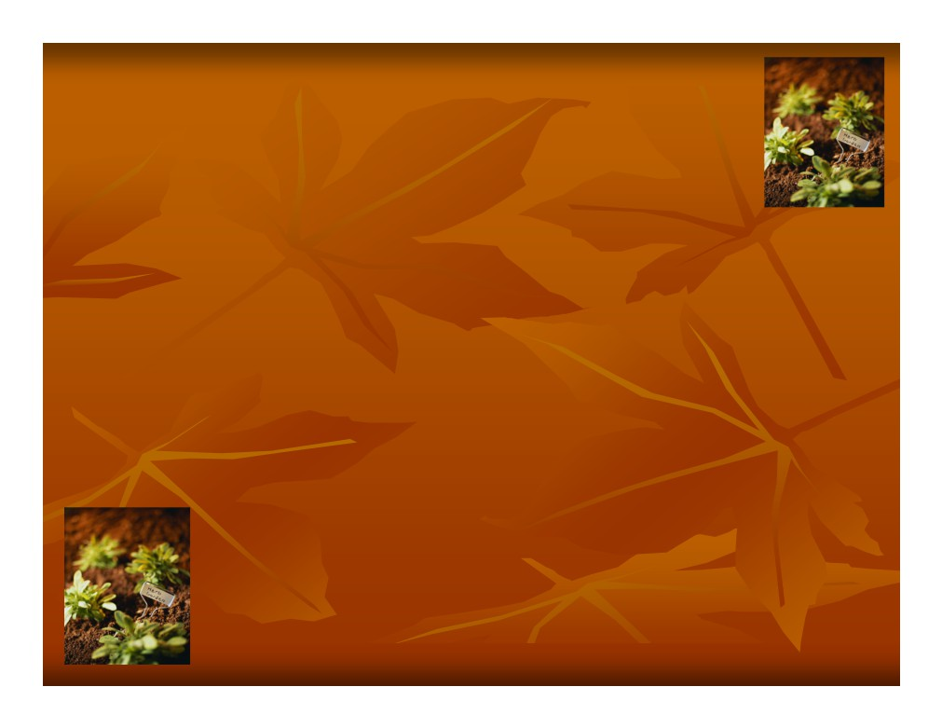
Soil!
Video Notes #6

Slide 2
What are we going to learn…
Soil-Why is it important?
What is soil?
Sand, Silt and Clay What’s a soil profile? Horizons?
Not all soil is brown Running out of dirt!

Slide 3
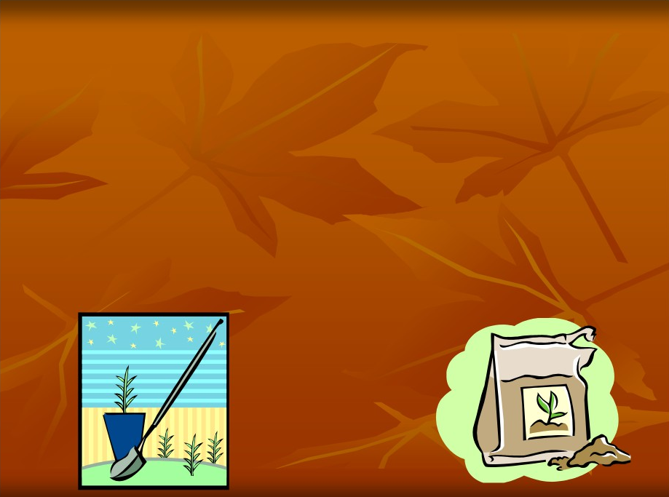
Objective 22: I can define Soil and why it is important
to me and the society in which I live.
Soil is a mixture of rock and mineral particles and organic matter. Soil covers the earth in a thin layer and
it is very important in plant growth.

Slide 4
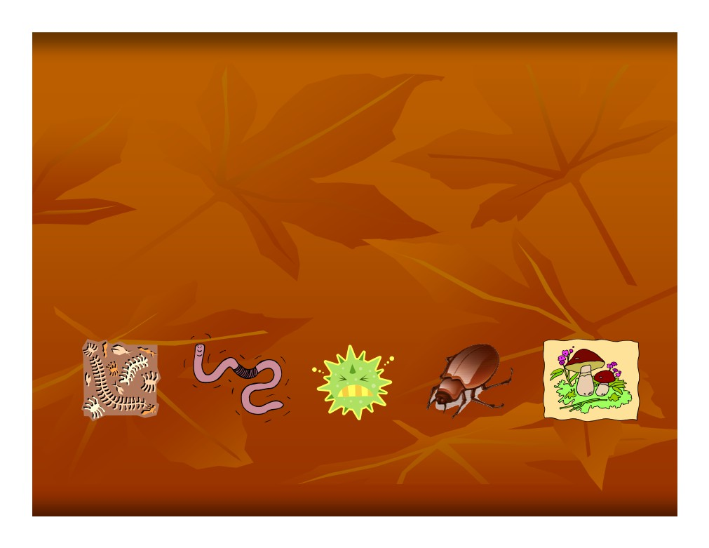
What exactly is in soil?
Soil is made up of mineral matter that has been broken down by chemical, physical and biological actions.
There are also living things in soil such as bacteria, fungi, mold, worms and insects.
The more living things the more productive the soil!

Slide 5
Why should I care about soil?
Soil is the #1 support for plants
Soil anchors the plants roots so that they don’t fall over
Soil is a superstore of nutrients For a plant to grow it needs 16 elements! (13 come from the soil!)
Moisture for the plants is stored in the soil

Slide 6
Objective 23: I can describe soil
Formation/Profile and distinguish
between the different horizons.

Slide 7
Soil Formation and Profile
A soil profile is a
vertical cross section through a soil.
It is made up of layers of soil material.
These layers are called horizons. Horizons differ from each other in color, texture and/or
structure
Decayed material in soil is called humus.

Slide 8
Parent Material
(Yes soils kind of have a Mom and Dad!)
Parent material - is the unweathered material from what soil is formed. This is the hard rock found under the soil.
The parent material has a strong effect on the properties of young soils
-If the parent material has lots of organic matter then the soil will be more acidic
- If the parent material is high in limestone then the soil will be more basic

Slide 9
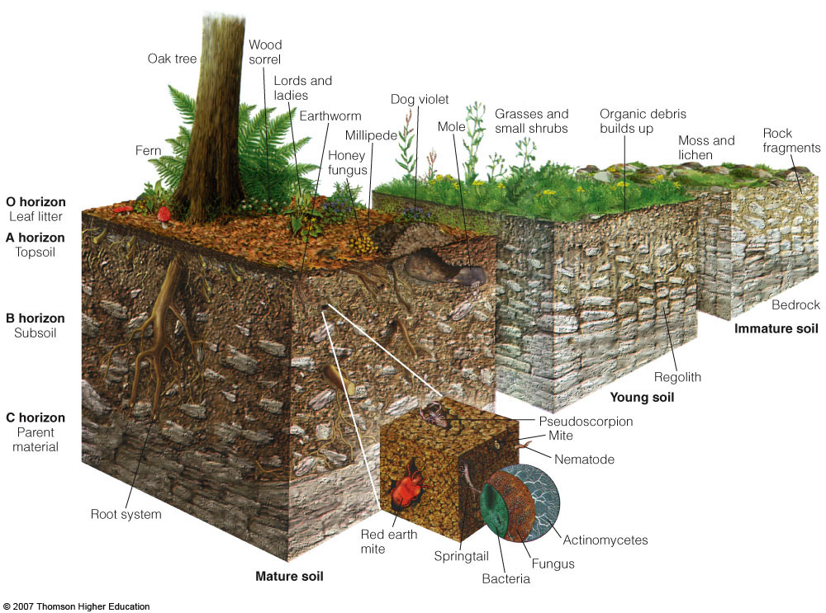

Slide 10
Horizons
“A” Horizon- This is the top part of the soil
where life is most active. It is the most
productive horizon because it has such a high organic matter and granular soil structure
“B” Horizon- Lies below the A horizon and is called the subsoil
“C” Horizon- Parent material horizon mostly composed of rock

Slide 11
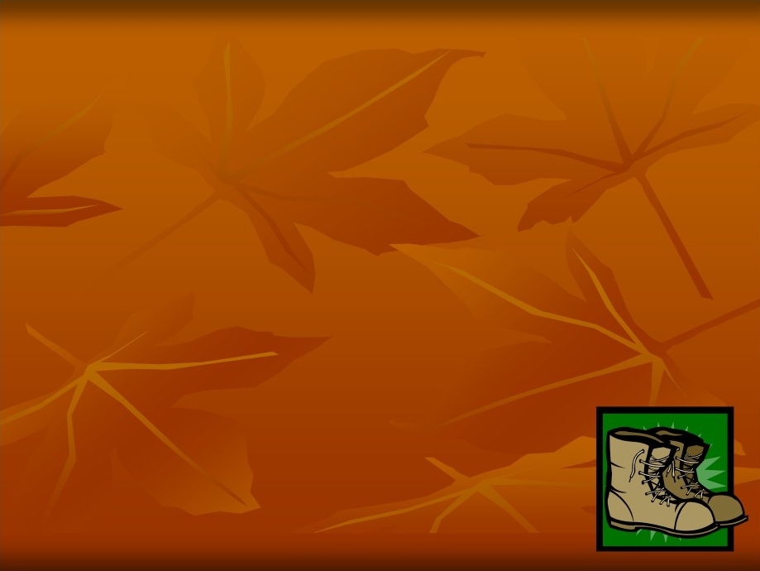
The A horizon: Topsoil
Can be a few inches to a foot deep
Is usually a pretty dark color Lighter texture than the B or C horizon
More likely to be a granular structure

Slide 12
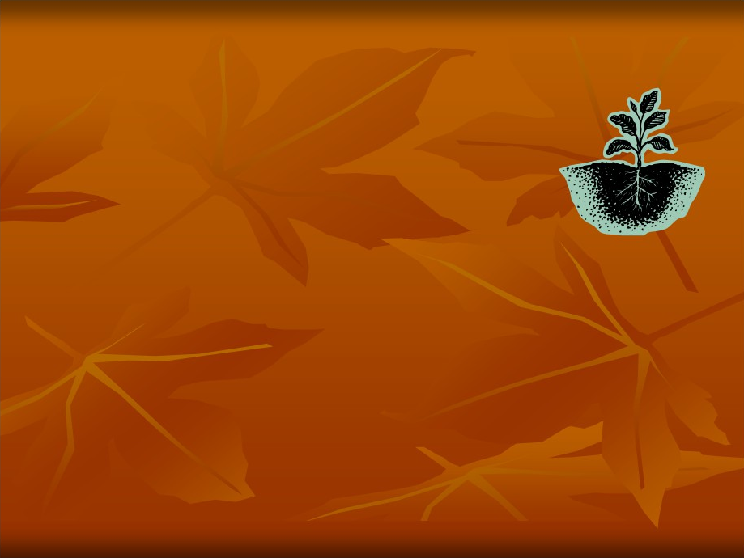
The B horizon: Subsoil
Low in organic matter
Red or yellow in color
Less desirable structure than the A horizon
Blocky or prismatic structure
Roots may extend into this horizon looking for moisture and nutrients

Slide 13
The C horizon: Parent Rock
Deepest of the 3 major horizons Low in organic matter
Coarse or rocky texture Undesirable structure
Lighter in color than A and B horizon
Rarely has roots or biological activity

Slide 14
Objective 25: I can describe soil other soil properties.

Slide 15
Texture, Structure, Depth and Color
Texture- How much sand, silt and clay is found in soil, is it fine or coarse
Structure- The mixture of the soil, how the
particles are arranged to make up the soil, the structure is not permanent! Think of it as…wet soil, or disking the soil
Depth- Important to plants, depends on rooting zone
Color- Soil color can tell us a lot…It can tell us about drainage and water and organic matter

Slide 16
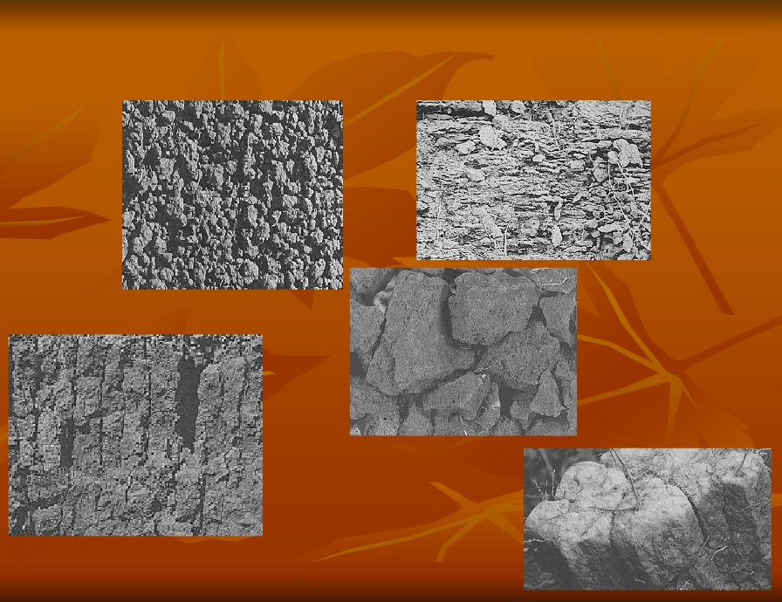
Soil and its Structures
Platy
Granular
Blocky
Columnar
Prismatic

Slide 17
SAND
(Think of the beach!)
Sand is small, coarse-grained pieces of rock.
We can see and feel the individual pieces It feels gritty. It doesn’t stick together or form clods.
It can be really fine or not so fine
Not much surface area is exposed
Sand increases space between particles,
which means air and water can move more freely, which means Sand is needed in soil to provide good drainage!

Slide 18
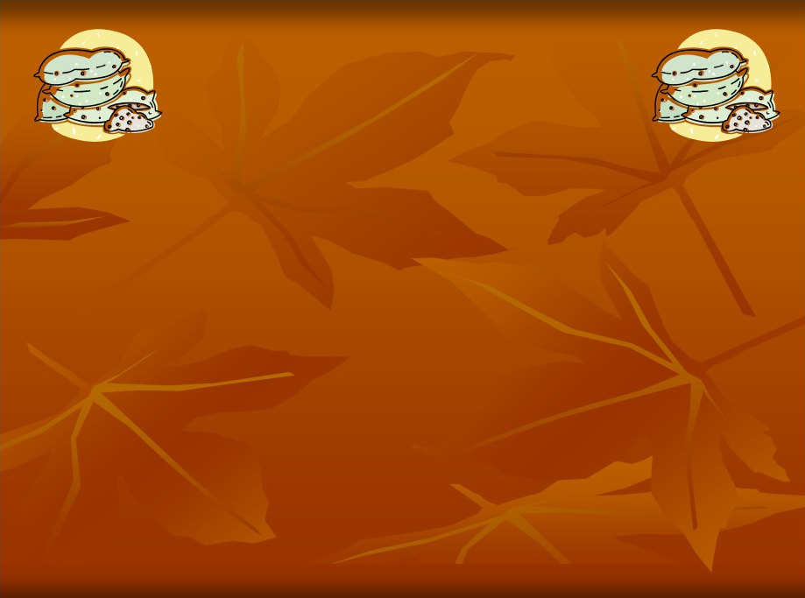
SILT
(Think of flour!)
Silt is really soft and powdery
Silt particles are so small that we can only see them with a microscope
Water soaks well into silt
Silt forms clods that crumble when wet so they are not good for mudballs!
Silt particles don’t stick together well
Soils with a good water holding capacity are high in silt

Slide 19
CLAY
Clay is even finer than silt
Clay particles are platy and thin in shape, they fit closely together with little space
Clay sticks together well and forms hard clods
A soil that contains lots of clay is considered “heavy”.
Clay has a large surface area because they are so small
The amount of clay in a soil has a great
impact on the soils water holding capacity

Slide 20
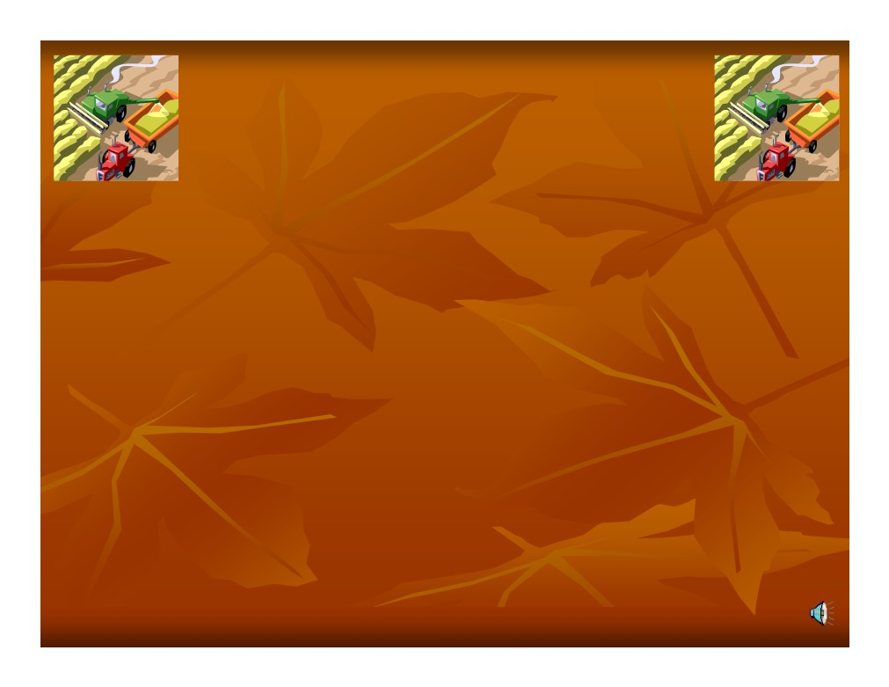
Soil Profile and Crop Production
If we know the soil profile then we can determine the vertical distance plant roots, water and air penetration
If the profile shows a shallow soil then we know to plant a crop with shallow roots
The profile also tells us about the soils water holding capacity

Slide 21
Soil Conservation
Plant and cultivate crops according to the contour of the land
Strip Cropping
Terracing
Crop Rotation
Build ponds/dams

Slide 22
